Slide 1

Car Dataset Analysis Objective: Derive Insights from Car Dataset.
01

Slide 2
Overview
Query Data based on Problem statement in SQL
Getting
Insights
Connect SQL Server to Excel
Getting insights from Data
Creating DashBoard
Creating DashBoard
Extracting
Data (SQL)

Slide 3
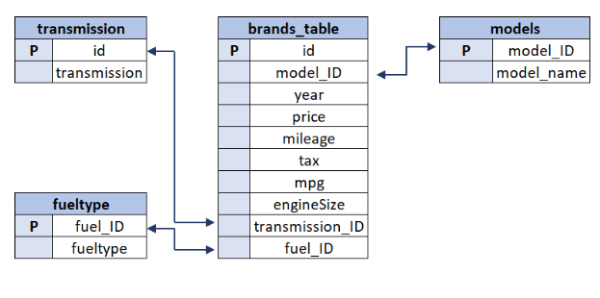
Contents Of Project
Problem Statements
Data Folder Schema Details
Data folder
Car Dataset SQL Queries
DashBoard

Slide 4


Meet The Team
Anurag Pandey
Mohan T. L
PD15_307
PD15_207

Slide 5
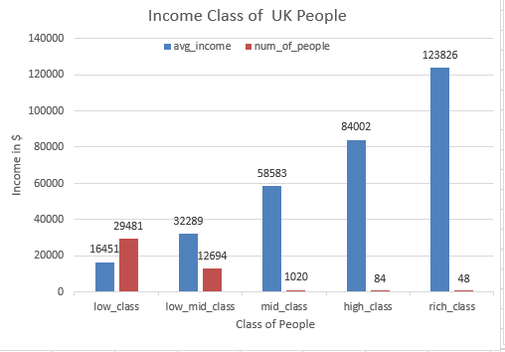
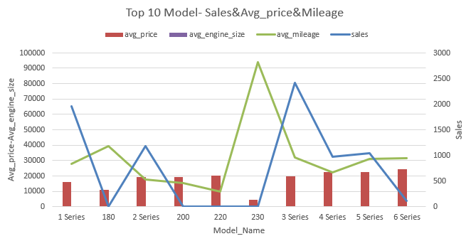
Insights From Cars Dataset
In UK the income of 90% people belong to Low and Low-Mid Income class .
Among top 10 models,Model -230 has the highest average mileage while model-3 series has the highest sales.

Slide 6
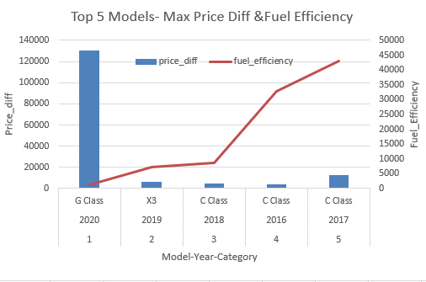
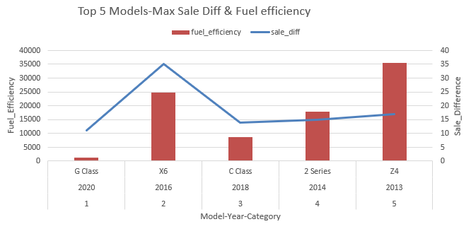
Insights From Cars Dataset
In Cars data , price difference over year has a negative relation,In 2020 G-Class model had the highest jump in the price while its efficiency was very low.
Among top 5 Car Models ,the highest jump in sales was found in 2016 with model name –X6 having high fuel efficiency

Slide 7
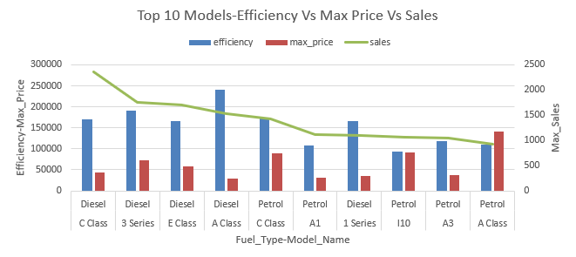
Insights From Cars Dataset
In Top 10 models with maximum price ,half of cars belong to fuel type – Diesel and other half to Petrol with C class model had highest Sales.

Slide 8
Conclusions
C- Class Model car is best suited for more than 90% of targeted Customers.
.

Slide 9
CHALLENGES FACED
Difficulty in SQL query with multiple data-sets (Lengthy Queries).
Difficulty in Connecting SQL with Excel through MS Azure
Insight and DashBoard issues.
.
Team challenges like communication – team of 4 reduced
to 2.

Slide 10
Thank you!

